Slide 1
A Note on the “Taylor Vortex”
Stefan P. Domino^{1,2}
¹ Computational Thermal and Fluid Mechanics, Sandia National Laboratories
² Institute for Computational and Mathematical Engineering, Stanford
SAND2018-4536 PE

Slide 2
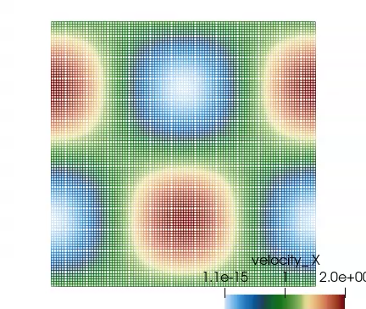
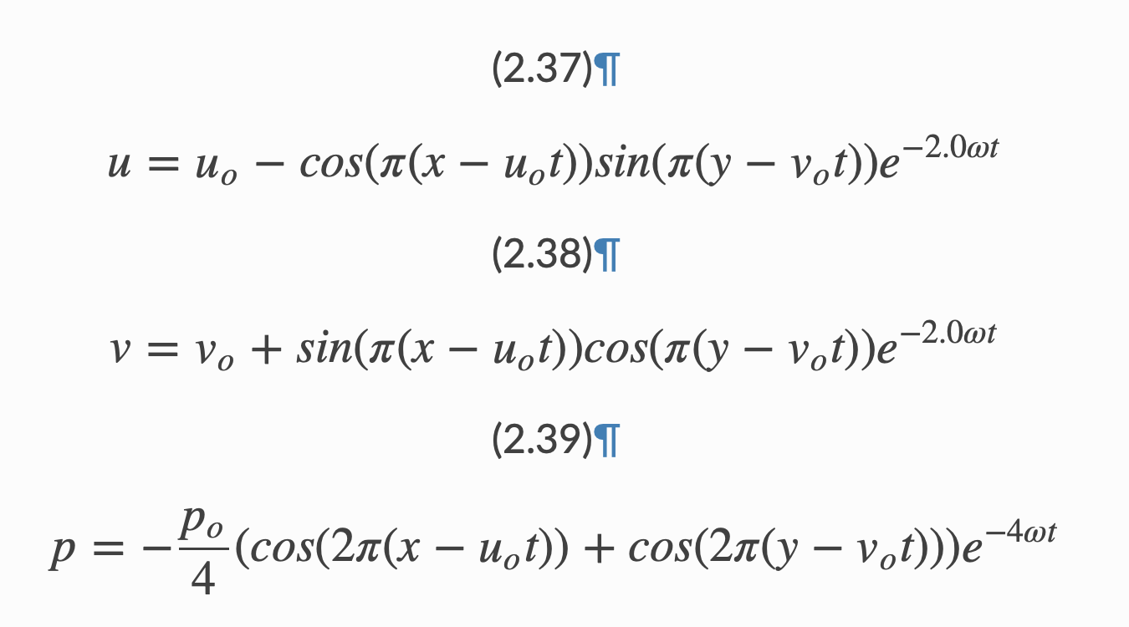
Convecting Taylor Vortex Verification
Convecting Taylor Vortex Case Study: Analytical, transient verification problem
Process: Compute error at a specific time while refining mesh

Slide 3
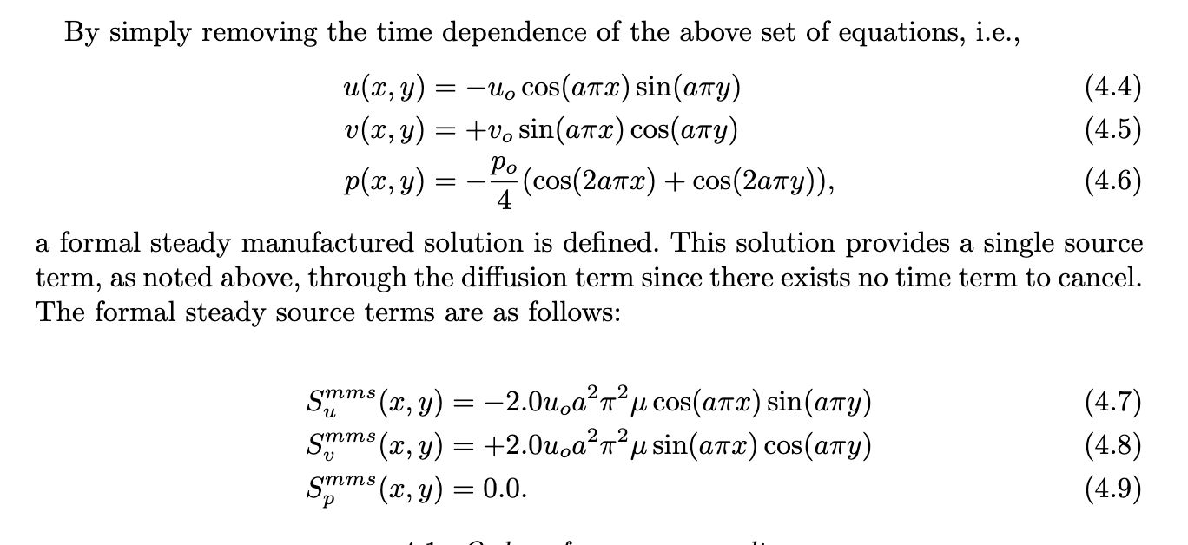
Steady Taylor Vortex Verification
Steady Taylor Vortex Case Study: Analytical (with source terms)
http://www.tonysaad.net/notes/the-amazing-taylor-green-vortex/

Slide 4
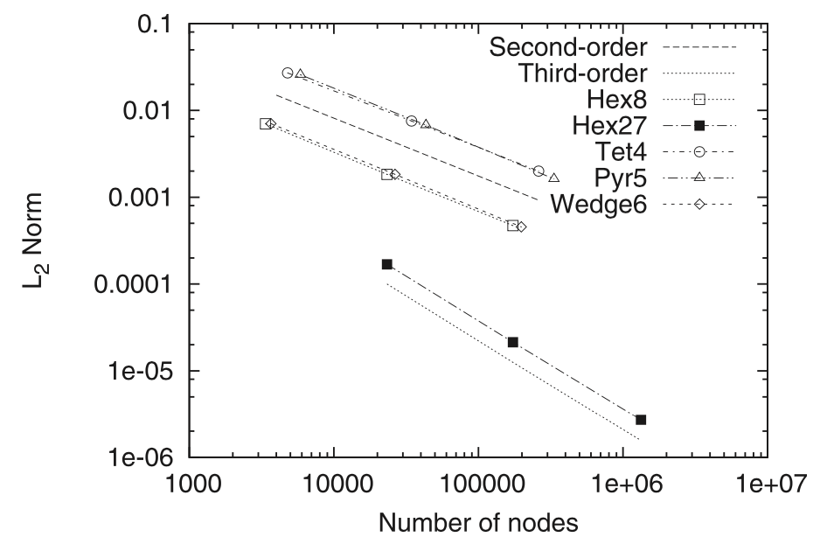
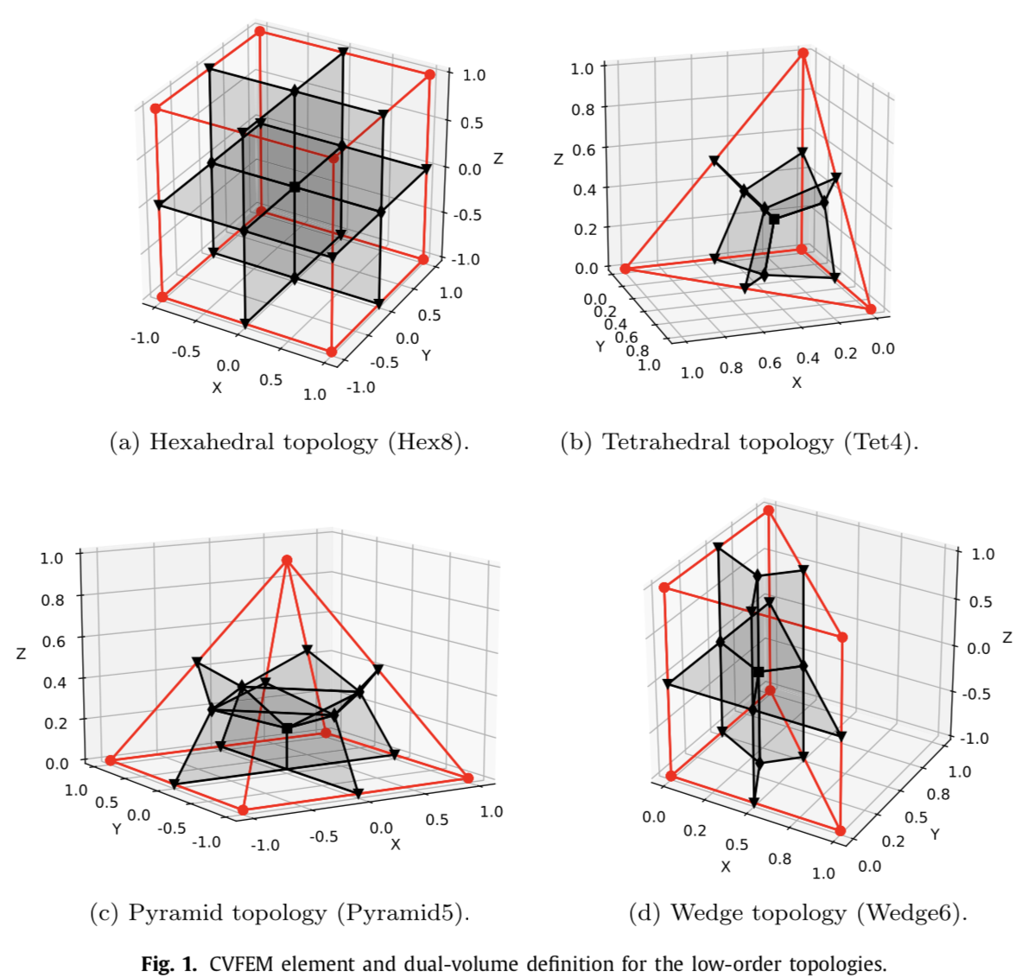
Order of Convergence Reporting: Number of Nodes (DOF locations) Plot

Slide 5
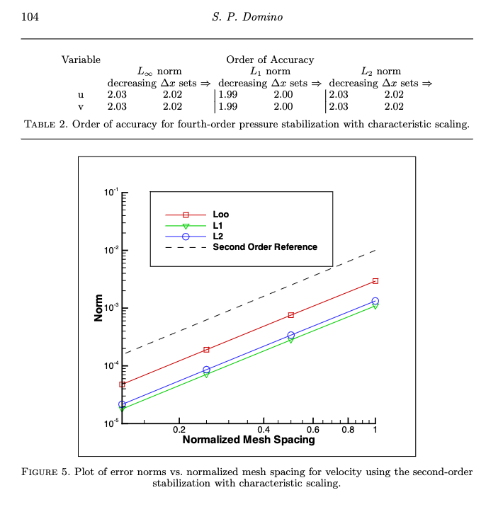
Order of Convergence Reporting: Normalized Mesh Spacing Plot

Slide 6
Order of Convergence Reporting: Apparent Accuracy Order
Apparent order of accuracy
Reduction of error as a function of mesh size, node count, etc.

Slide 7
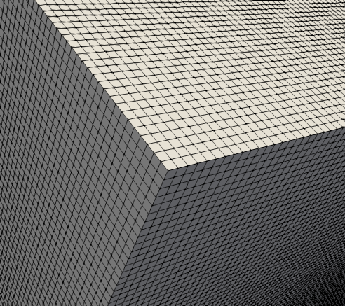
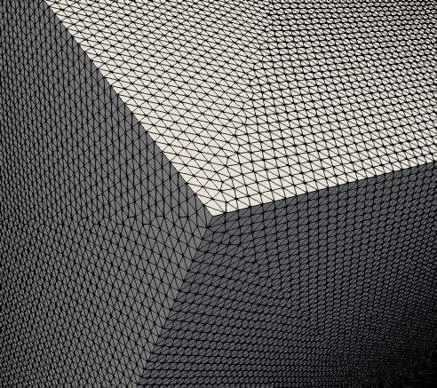
Taylor-Green Vortex (Re 1600): Solution; Sample Hex and Tet mesh
equation_systems:
name: theEqSys
solver_system_specification:
uvwp: solve_scalar
systems:
- LowMachMonoEOM:
name: myLowMach
max_iterations: 1
convergence_tolerance: 1e-2
Initial Condition Provided:
initial_conditions:
- user_function: icUser
target_name: block_1
user_function_name:
velocity: TaylorGreen
pressure: TaylorGreen

Slide 8
Taylor-Green Vortex (Re 1600)
Well studied problem that is part of the following numerical benchmark:
“C3.5 DNS of the T/G Vortex at Re = 1600”
QoI: turbulent kinetic energy vs time and dissipation rate vs time
First phase: small viscous effects, small-scale structures are laminar and organized [easy]
Second phase: viscous (diffusion) dominates, structures are distorted [harder]
Break-up phase: flow is dissipating fully [easy]
Phase 2
Phase 1
German Aerospace Center

Slide 9
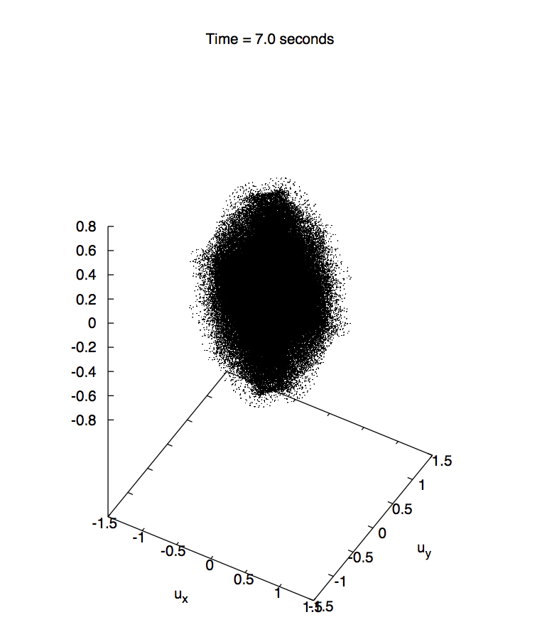
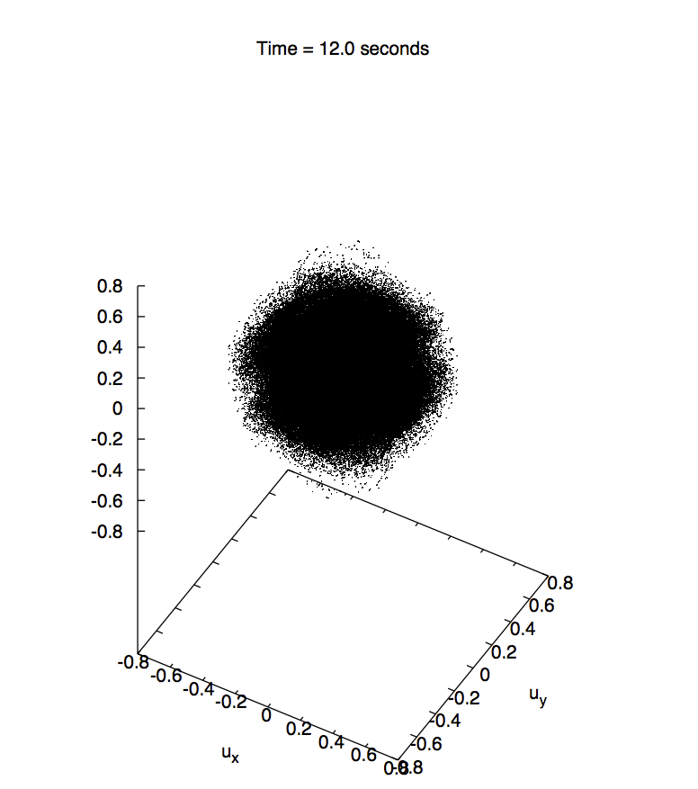
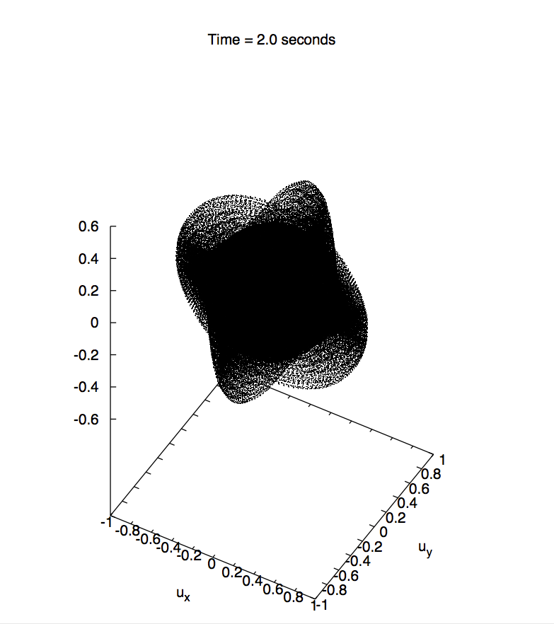
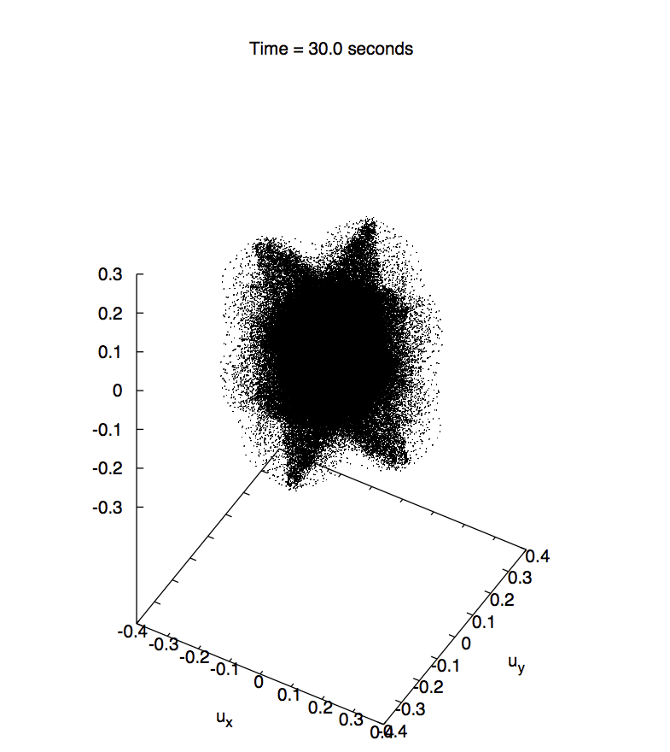
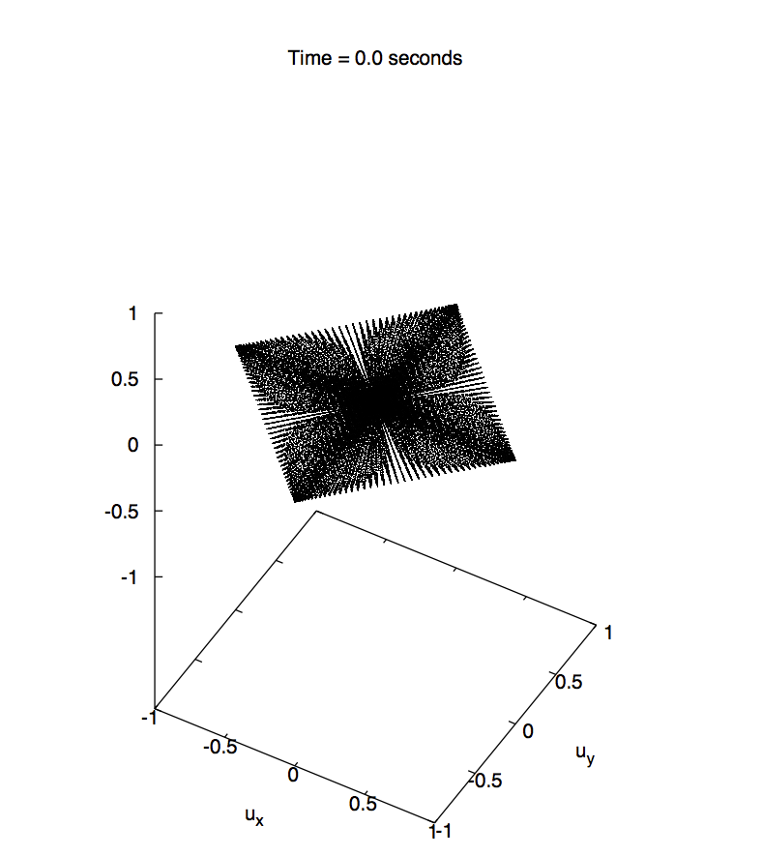
Phases
German Aerospace Center

Slide 10
Taylor-Green Vortex (Re 1600): Exampe
Findings from Domino et al., Comput. Fluids (2019)
All topos converge to baseline DNS
Pyramid5/Wedge6 (at R1) looks very good

Slide 11
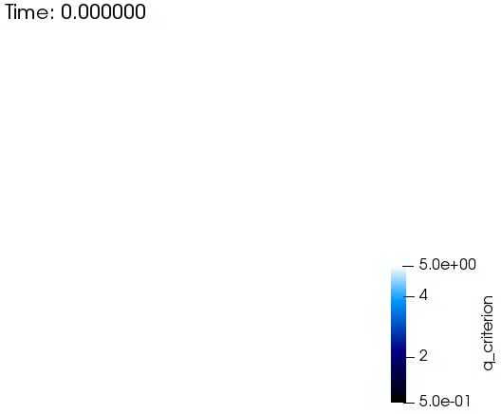
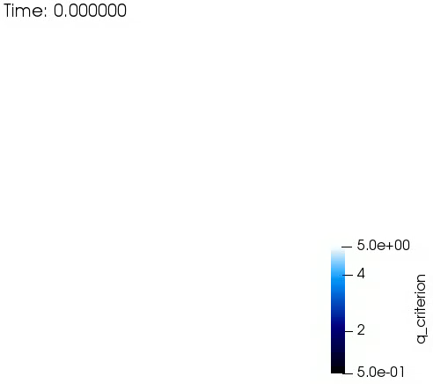
Hex8, Tet4, and Wedge6 Re = 1600 Result
Hex8
Tet4
Wedge6

